Slide 1

AIRLINE RESERVATION SYSTEM

Slide 2

Book Your Flight with Ease
Search for flights by entering your origin, destination, and travel dates.
Filter your search results by price, airline, departure time, and arrival time.
Select the flight that best suits your needs and preferences.

Slide 3

Book Your Flight in Minutes
Specify your travel details
Choose your preferred cabin class (economy, business, first)
Select add-ons like seat selection or extra baggage allowance
Review your flight itinerary before confirming

Slide 4

Manage Your Reservations with Confidence
Cancel flights with a few simple clicks
Make changes to your itinerary as needed
View and manage all your upcoming reservations
Edit passenger details, travel dates, or flight times (subject to availability)

Slide 5

Secure Online Payment Processing
Enjoy peace of mind knowing your payment is protected
Utilize industry-standard encryption to safeguard your financial information
Accept all major credit cards for secure transactions

Slide 6
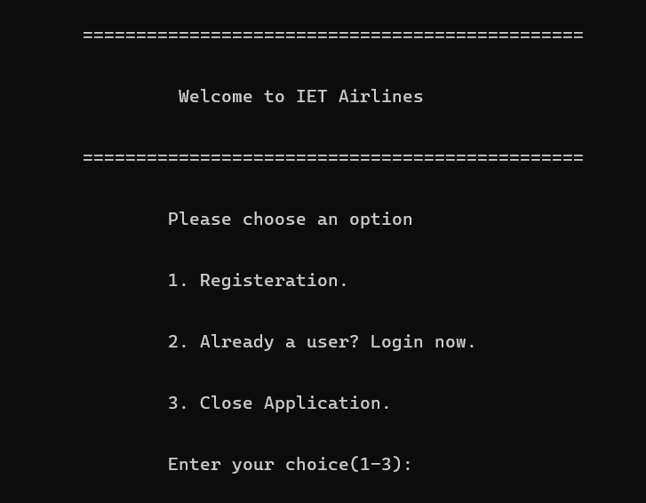

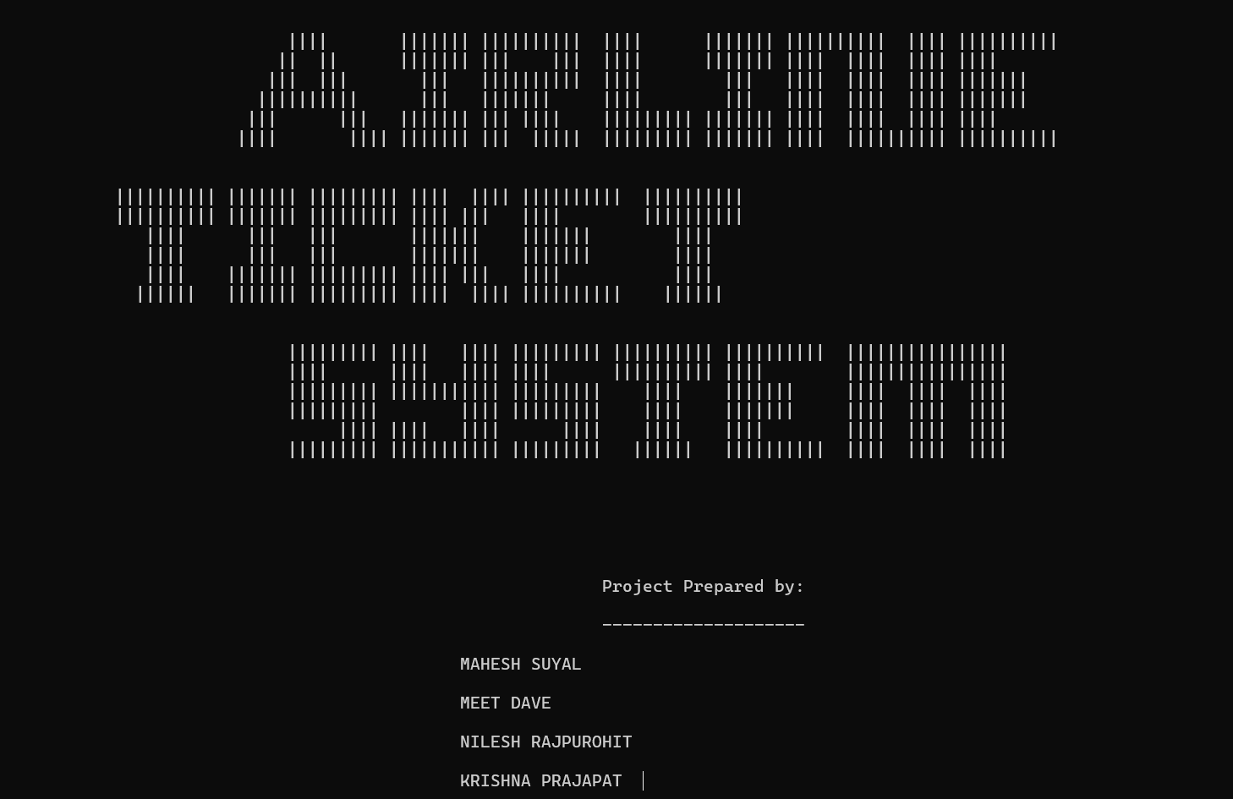

SNAPSHOTS

Slide 7
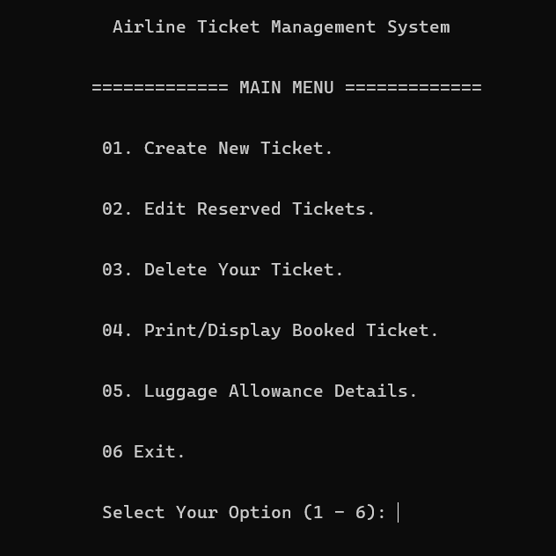
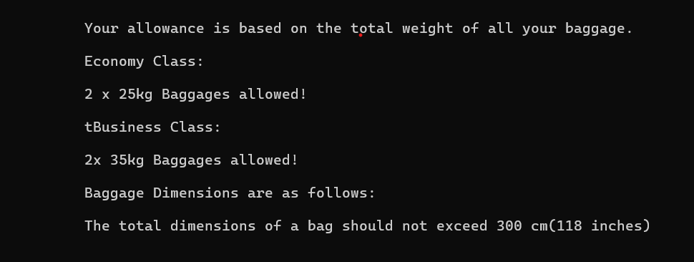

Slide 8

THANK YOU!!

